Slide 1
Including scale when analyzing high throughput sequencing datasets (Computational paradigms in molecular biology revisited)
Greg Gloor
ggloor@uwo.ca
@gbgloor
@gbgloor.bluesky.social

Slide 2
How we get our data
Reality
Measurement

Slide 3


Our data in reality
Reality
Measurement

Slide 4
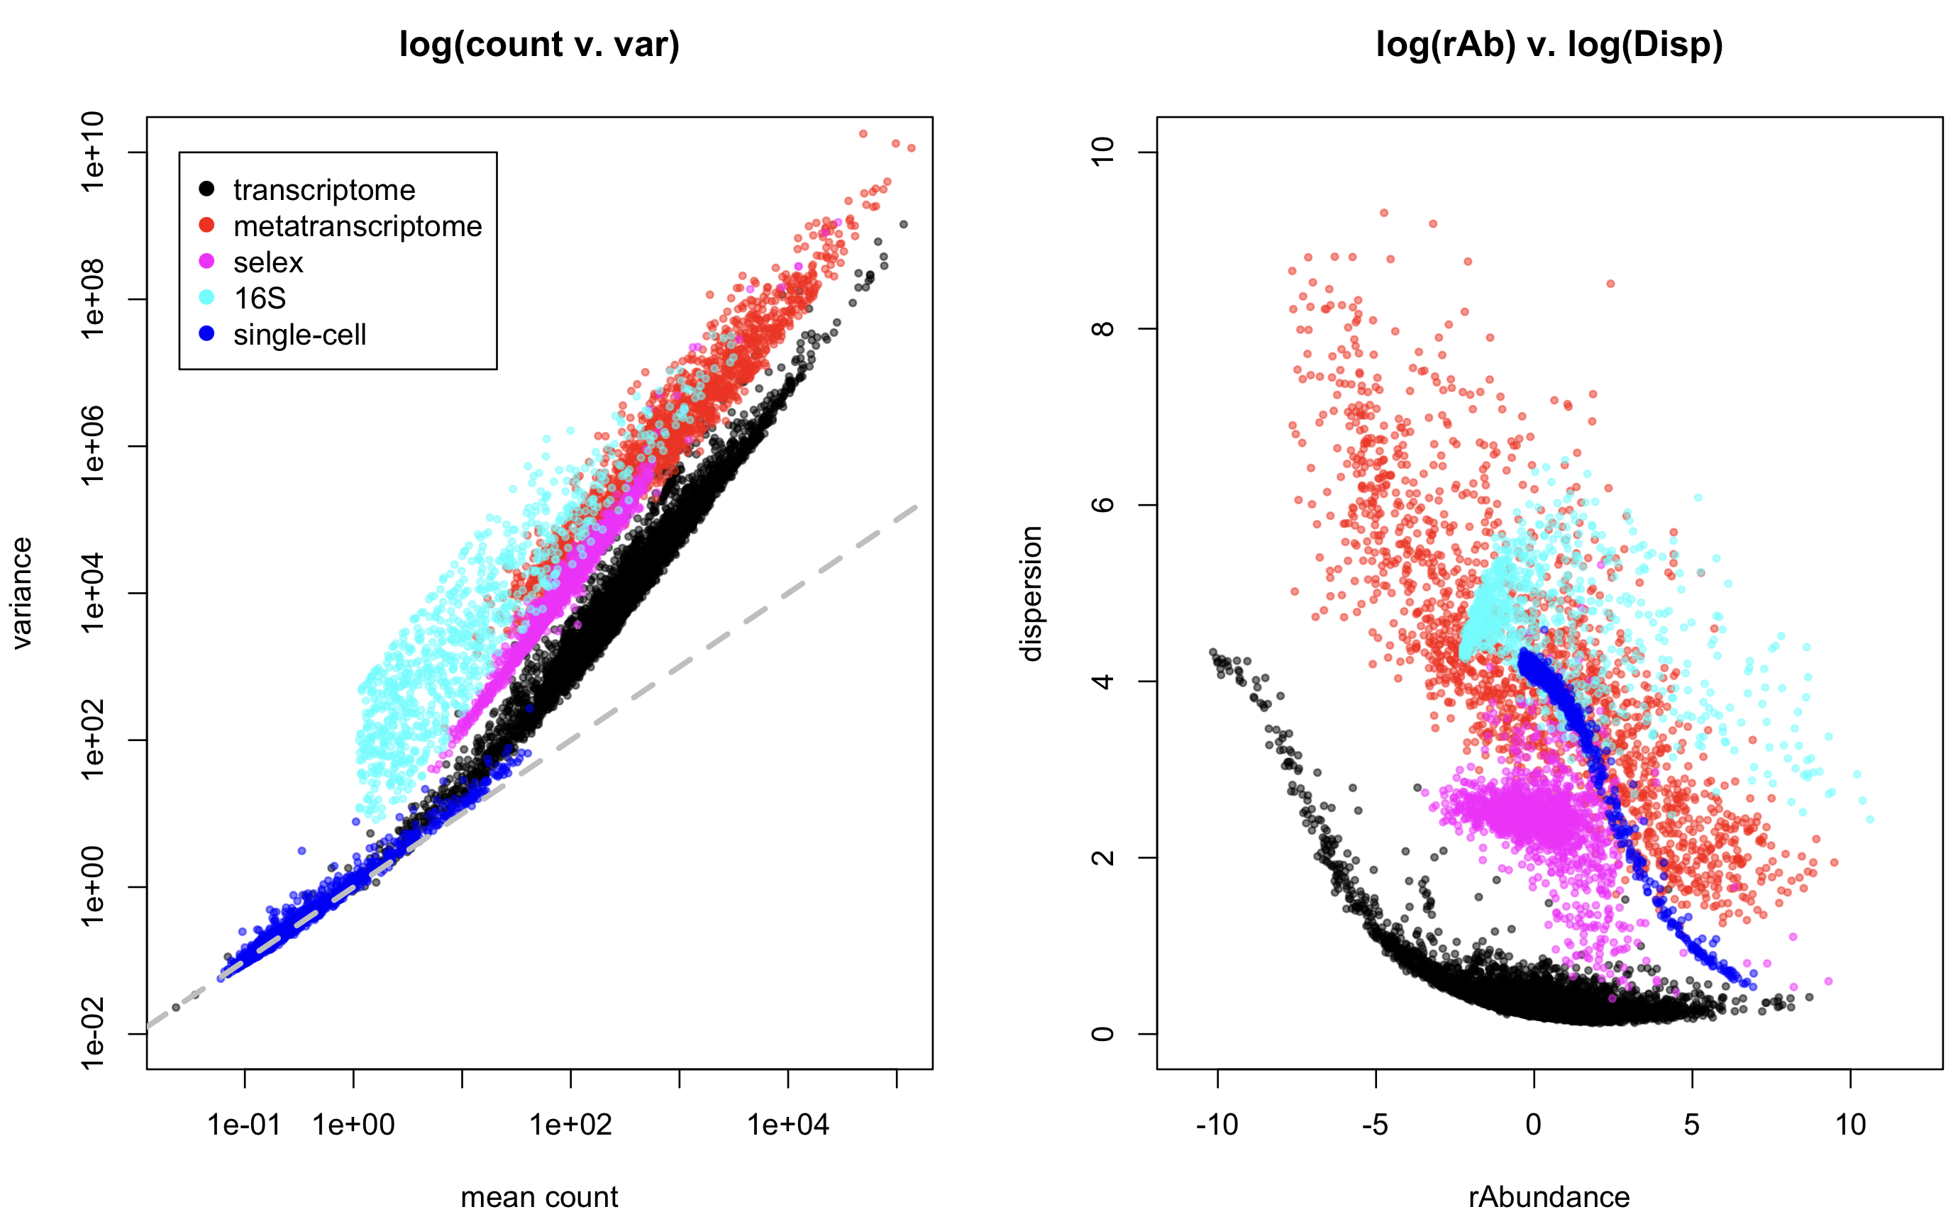
All data are NB, but …

Slide 5
Dispersion vs. count

Slide 6
Bad data
Assumptions of all tools and normalizations
Very few DA features
DA is symmetric or at least stochastic
Equal underlying environmental abundance
Bad data
Many DA features
Asymmetric data
Different environment sizes

Slide 7

Dark underbelly of HTS
Domain-specific tools
Why not treat all HTS data the same?
Dataset-specific workflows/analyses
Why use multiple approaches?
Instability in results
Why does sub-setting change outcomes?
Correlation!
Is there a general solution?
General lack of robustness

Slide 8
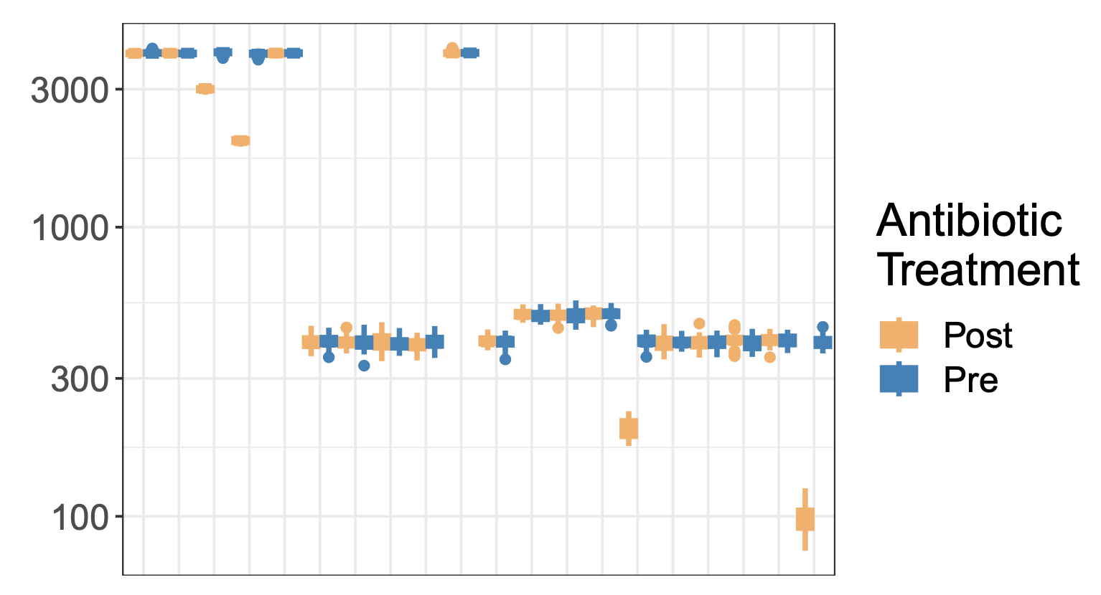
Drivers
‘Bad’ HTS data is shockingly easy to generate
Model chemostat experiment
Mis-estimation of scale causes issues for compositional systems
Unacknowledged bias in specifying scale causes commonly observed analysis artefacts

Slide 9
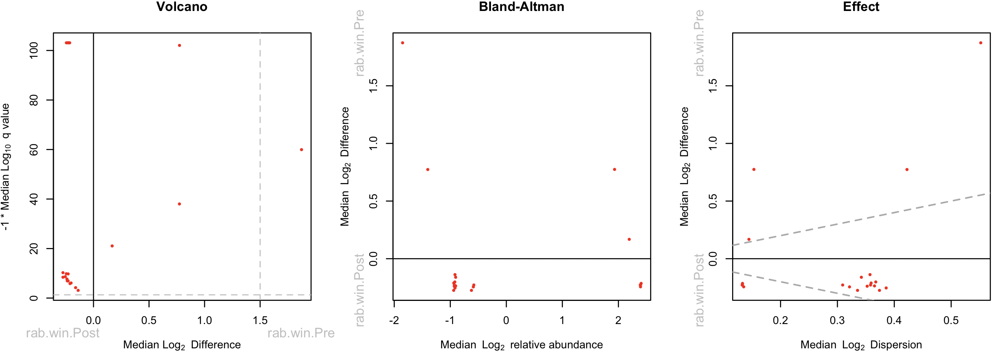
Plot your data

Slide 10
Diagnosing bad data
Too many things ‘significant’
Something must be invariant
q-score is unrealistic
Mismatch between model and test
Too much ‘power’ for sample size
No real variation
Many parts have 0 variance
Asymmetry
Few features on the line of no difference
Even ’good data’ can be actually bad!

Slide 11
Single-cell RNA-seq
‘Good’ HTS data can be ‘bad’
Massively sparse
Cell types asymmetrical

Slide 12
selex
‘Bad’ HTS data is shockingly easy to generate
Uni-directional change

Slide 13
Meta-transcriptome
‘Bad’ HTS data is shockingly easy to generate
BV v H metatranscriptome dataset
Scale misspecification at play here
H / BV bacterial load ~ 1/10 – 1/100
- bulk scale ~8X
- housekeeping scale ~1.15X

Slide 14
Yeast transcriptome
‘Bad’ HTS data is shockingly easy to generate
Too many samples, too much power
Very low variance as used for DA

Slide 15
E. coli transcriptome
‘Good’ HTS data can be ‘bad’
Near 0 variance as used for DA

Slide 16
Formally
The data table is a composition containing only relative data: Y∥
Y∥ is a D x N matrix
We want to know something about the environment: W
W=W∥ W⟂
W is a D x N matrix
Y∥_{dn} ≅ W∥_{dn}
Is a realistic estimate of W hopeless?

Slide 17
Enter Scale (Silverman,Nixon)
Data are normalized to make samples commensurate
Normalizations try to find latent information
Always assume most parts are invariant …
Normalizations are ratios (r)
Y^{∥(r)}_{dn}= Y∥_{dn} / 𝑓(Y∥)
True for RPKM, TPM, proportion, RLE, TMM, CLR, ILR, …
The CLR can be interpreted as a scale
CLR(Y∥) = log₂(Y∥_{dn}) – log₂(G(Y∥_{.n})) = log₂( Y∥_{dn} * 1/G(Y∥_{.n}) )
1/G(Y∥_{.n}) ≅ W⟂_{.n}
CLR thus resembles: log(W) = log(W∥) + log(W^{⟂)}
Silverman/Nixon showed that these were equivalent
and that this equivalence was useful

Slide 18
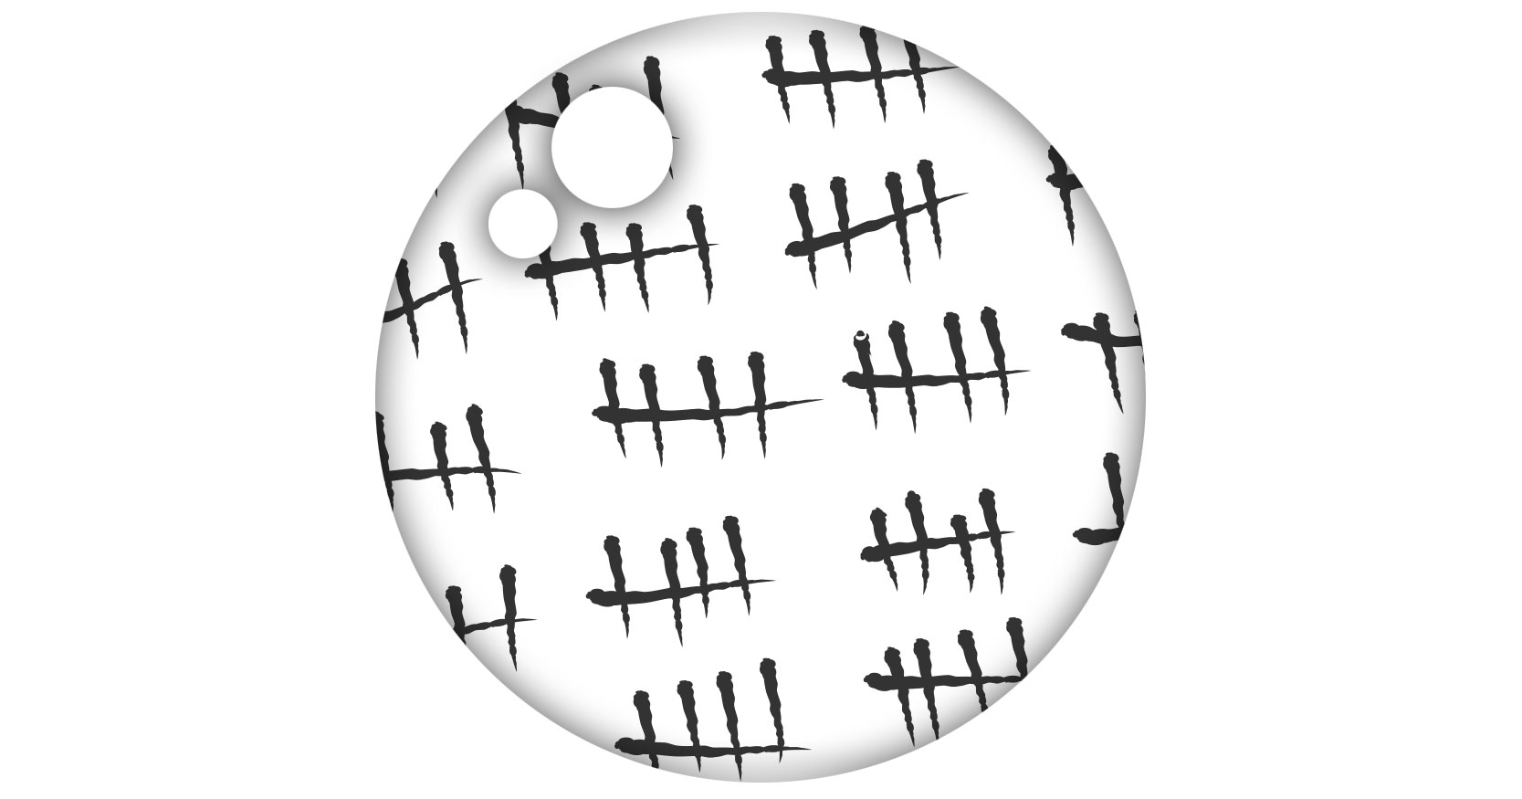
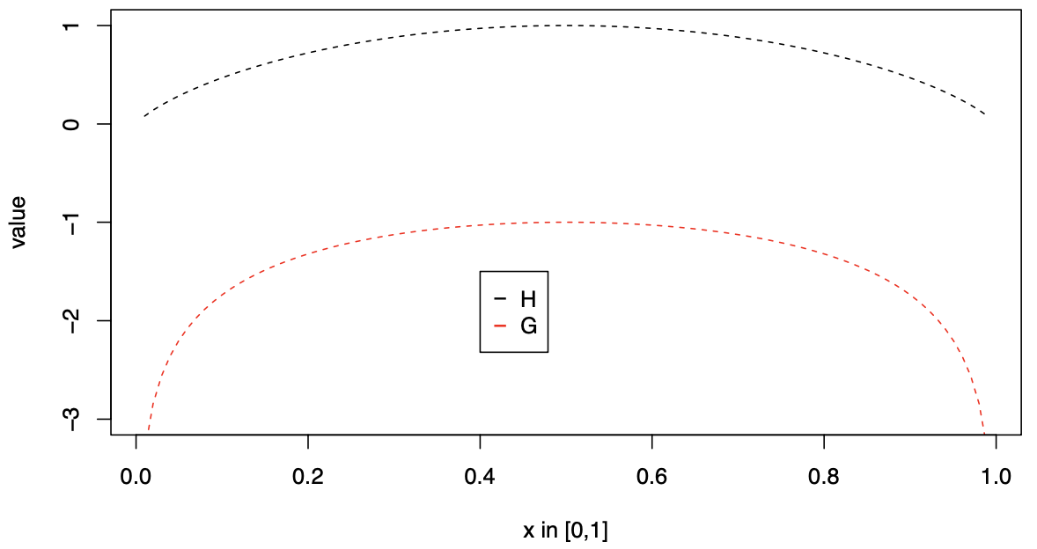
What is scale?
Known counts
Data from cell counting
Data from spike-in controls (but …)
Data from abundance measures
…
Information
log₂(1/G(Y∥_{.n})) = -log₂(G(Y∥_{.n})) = h₂(Y∥_{.n})
Expected Information (Shannon)
log₂(G(Y∥_{.n})) ≅ H₂(Y∥_{.n}) + C + 𝛖
Substitutable!
Entropy interpreted as volume or size in QIT

Slide 19
CLR(Y∥) is a poor approximation of W
Both Y∥_{dn} and G(Y∥_{.n}) are point estimates
All other normalizations less interpretable
Nixon/Silverman show that CoDa/ sequencing is PID and that a full posterior model has less bias
From Gustafson 2015

Slide 20
Let’s build a posterior model (ALDEx2)
Build a posterior model from the observed counts
Ŵ^{∥(s)}_{.n} ≅ Y^{∥(s)}_{.n} = Dir(Y∥_{.n})
Include uncertainty in the scale
Ŵ^{⟂(𝛖)}_{.n} ≅ h(Y∥_{.n}) + 𝛖 = -log₂(G(Y∥_{.n})) + 𝛖
Combine into posterior model of the environment
Ŵ_{.n} = Ŵ^{∥(s)}_{.n} Ŵ^{⟂(𝛖)}_{.n}
‘CLR’ with uncertainty in the numerator and denominator
Can also include uncertainty in the location of Ŵ^{⟂(𝛖)}_{.n} with outside information

Slide 21
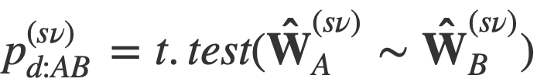
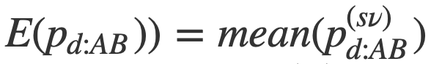
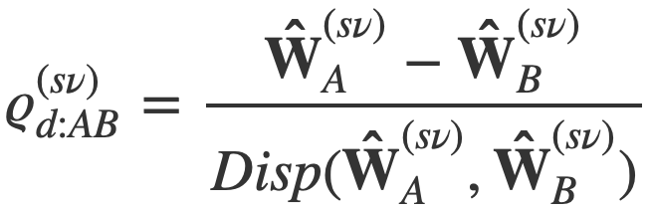
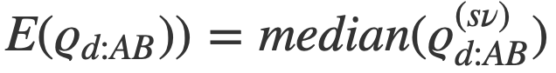
Calculate test statistics (ALDEx2)
Can calculate posterior test statistic if A=d[1:i], B=d[j,n]:
And then an approximate posterior predicted p-value:
And a posterior effect size:
And reduce to point estimate:

Slide 22
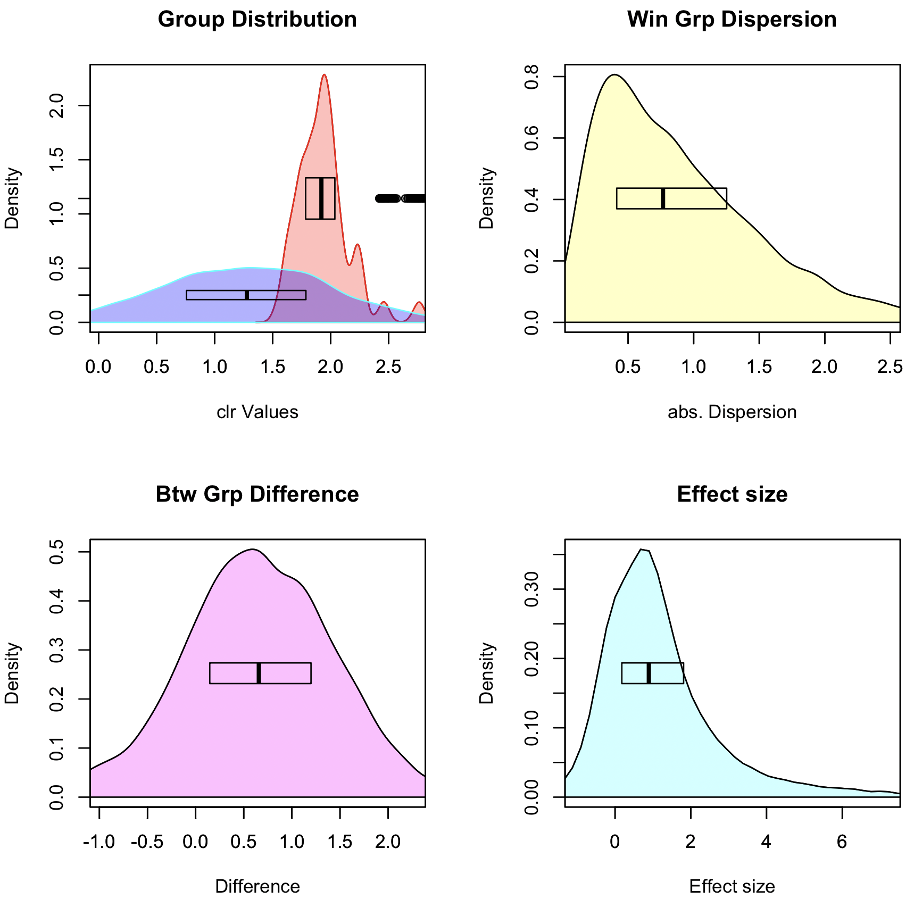
Graphical intuition
Posterior distributions:
rab.A, rab.B
Pooled dispersion: diff.win
Pooled difference: diff.btw
Pooled Effect: effect

Slide 23
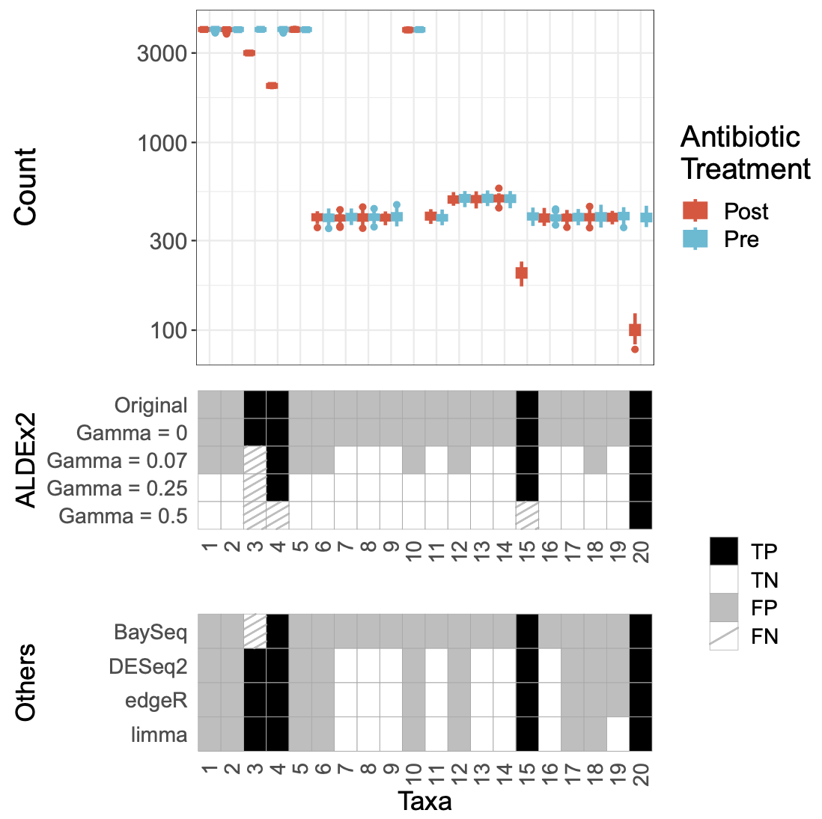
Simulated bioreactor
Simulated bioreactor data
High FP rate across the board
Data are asymmetric
Adding scale removes FP

Slide 24
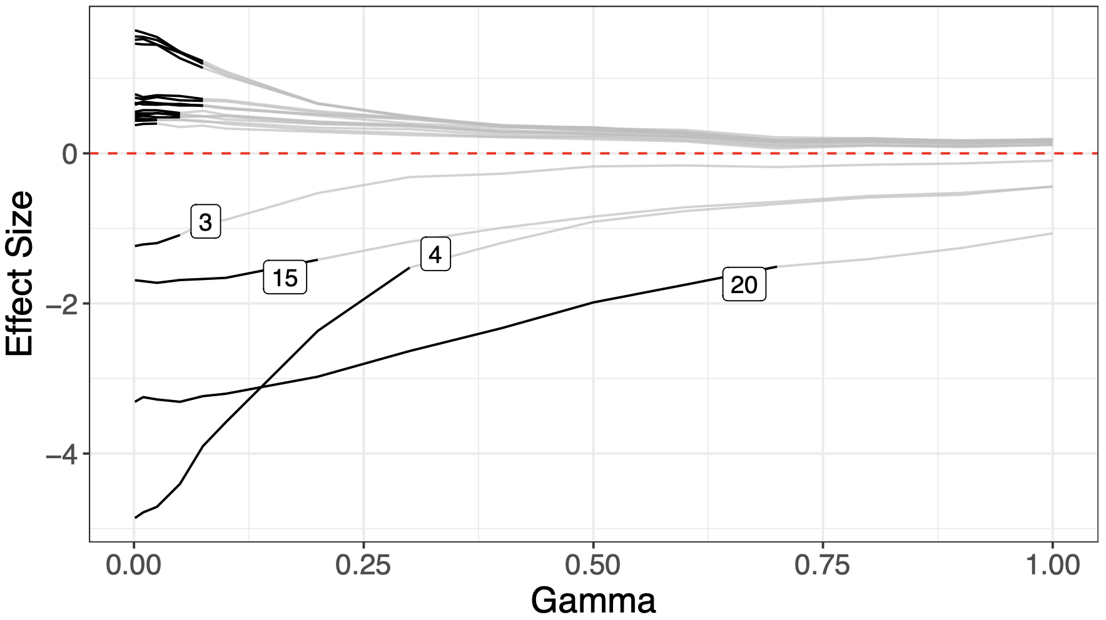
Bioreactor sensitivity analysis
Simulated bioreactor data
High FP rate across the board
Data are asymmetric
Adding scale removes FP
Sensitivity analysis can help find scale settings

Slide 25
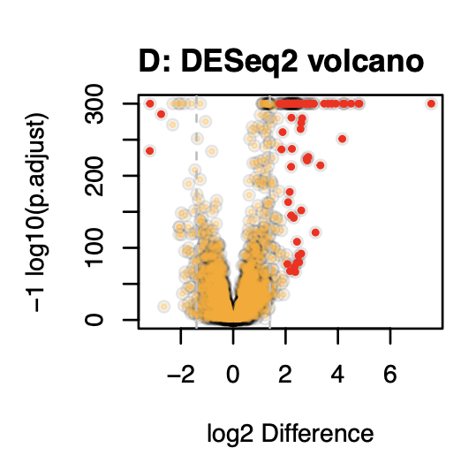
Unacknowledged bias in practice
Observation that too much data is counterproductive (Schurch)
In a highly replicated RNA-seq experiment over 70% of transcripts are DA
Biologically implausible
Breaks assumption of normalization (RLE)
Dual cutoff solution
Jussi (RPE vs HepG2)

Slide 26
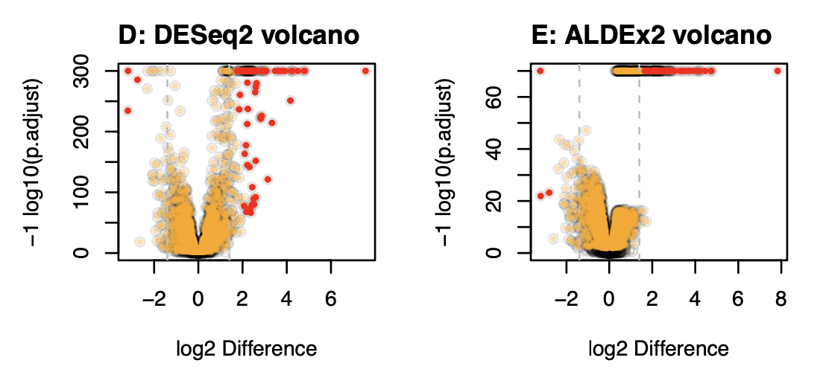
Overpowering is normalization independent
Jussi (RPE vs HepG2)

Slide 27
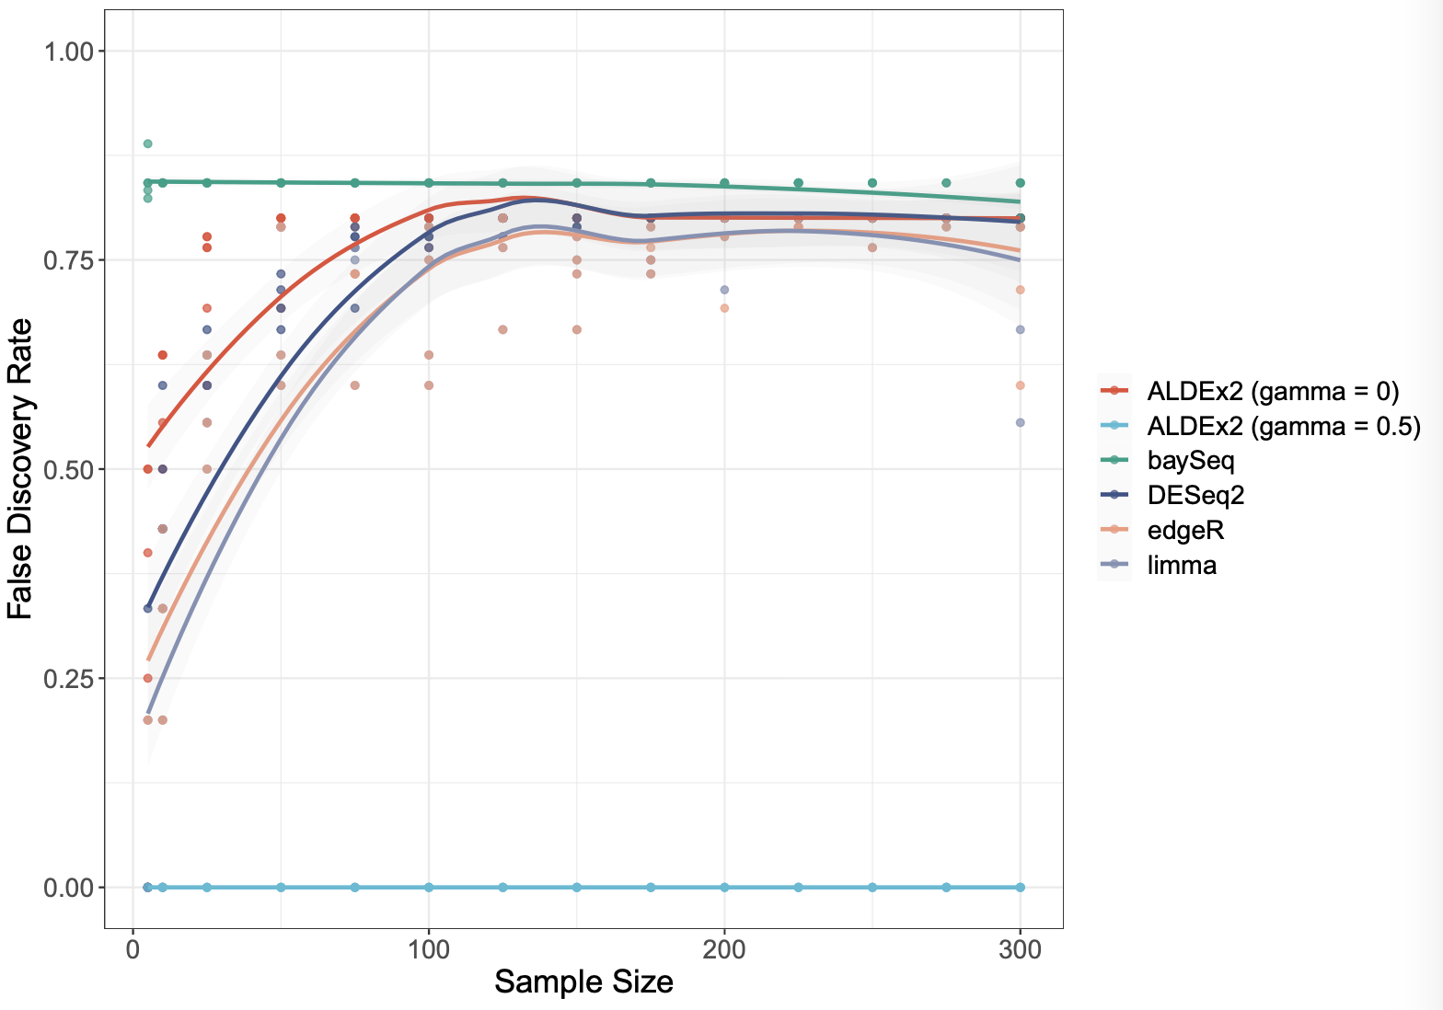
Scale keeps sensitivity, removes overpowering
Simulated bioreactor data
High FP rate across the board
Data are asymmetric
Adding scale removes FP
Sensitivity analysis can help find scale settings
Increasing sample size makes problem worse for all tools but the scaled model

Slide 28
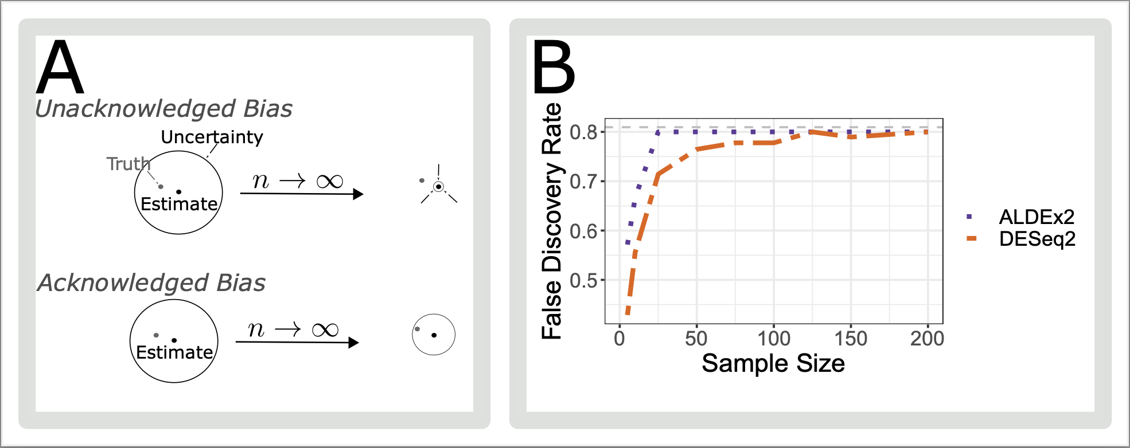
Because - unacknowledged bias

Slide 29
Summary
HTS data are partially identifiable:
Scale is assumed, wrongly, by all tools to be estimated properly
Accounting for scale prevents shrinking to a known wrong estimate
Better inference is obtained if all parameters are estimated including scale
As a minimum can determine what is robust to scale uncertainty
Uncertainty is not a bad thing if you remember
A – your data are uncertain
B – therefore the results are uncertain
C – therefore your interpretation must allow for uncertainty
D – uncertainty and skepticism should be your default state

Slide 30
Summary
HTS data are a form of partially identifiable data
Scale is assumed, wrongly, by all tools to be estimated properly
Accounting for scale prevents shrinking to a known wrong estimate
Better inference is obtained if all parameters are estimated including scale
As a minimum can determine what is robust to scale uncertainty
Uncertainty is not a bad thing:
A – your data are uncertain
B – therefore the results are uncertain
C – therefore your interpretation must allow for uncertainty
D - ‘Biological systems’ are only as different as they need to be (Jussi)

Slide 31
Adding scale uncertainty …

Slide 32
Adding scale uncertainty …

Slide 33
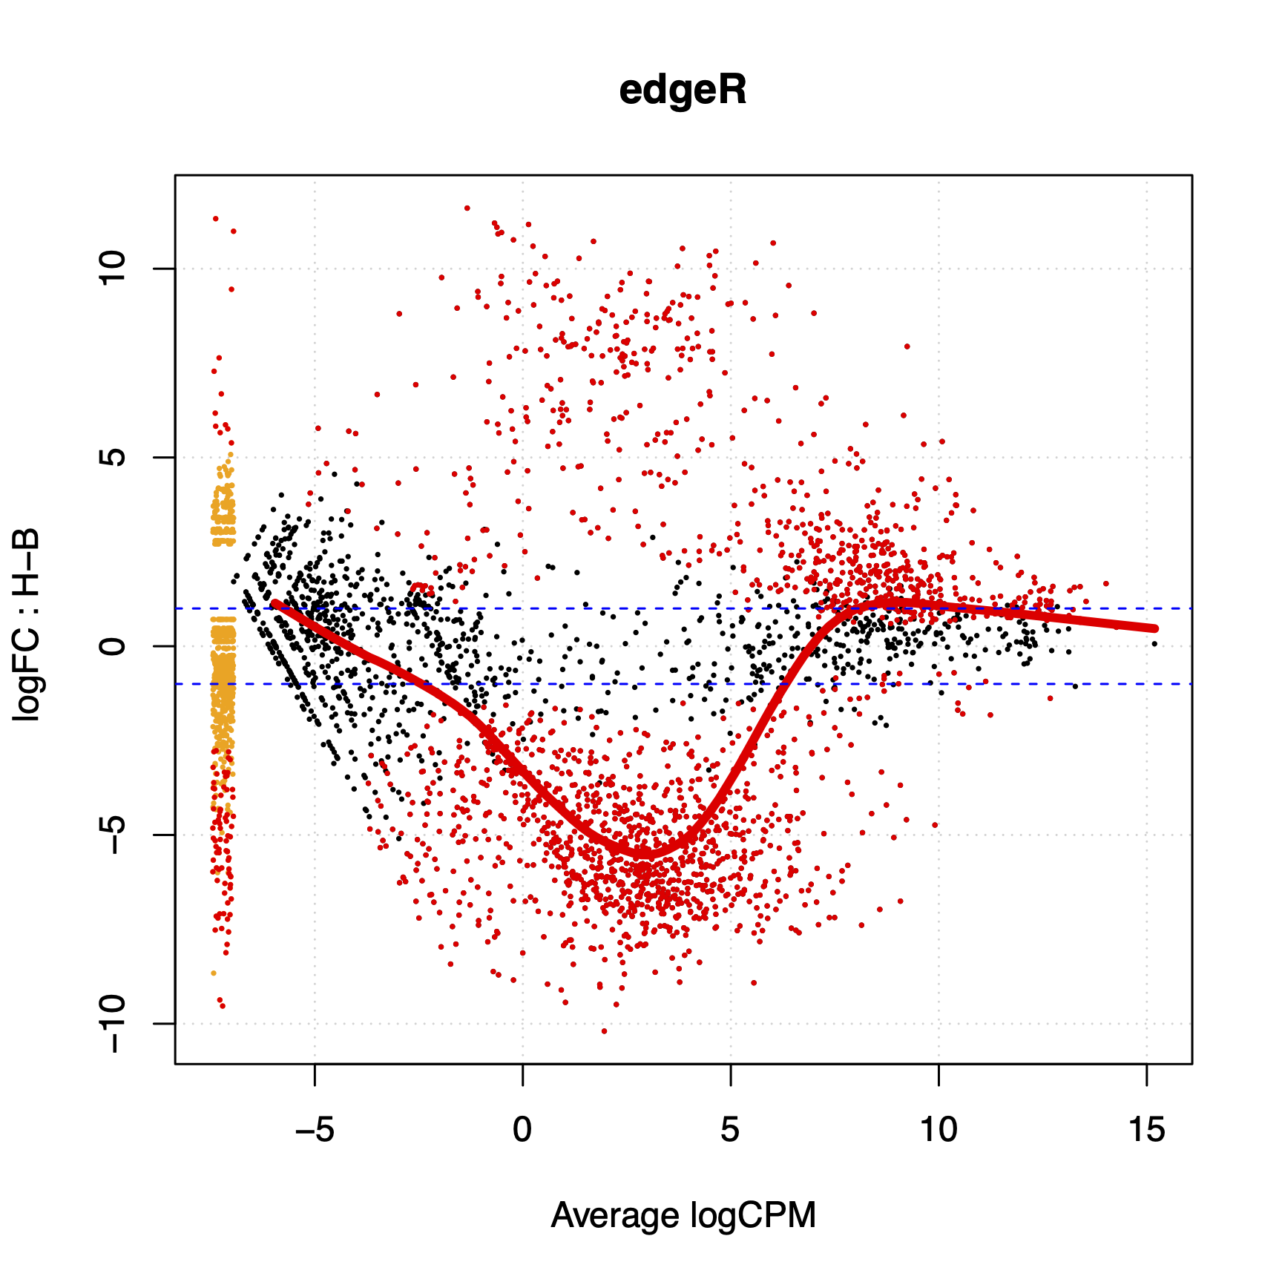
What about my problem?
Scale can be added on a per-group or per-sample basis
Differential scale changes the location of the data
This depends only on the ratio of the scales, not on the value of the scales
Yes, the normalization value is irrelevant but the ratio between the values for different groups is important

Slide 34
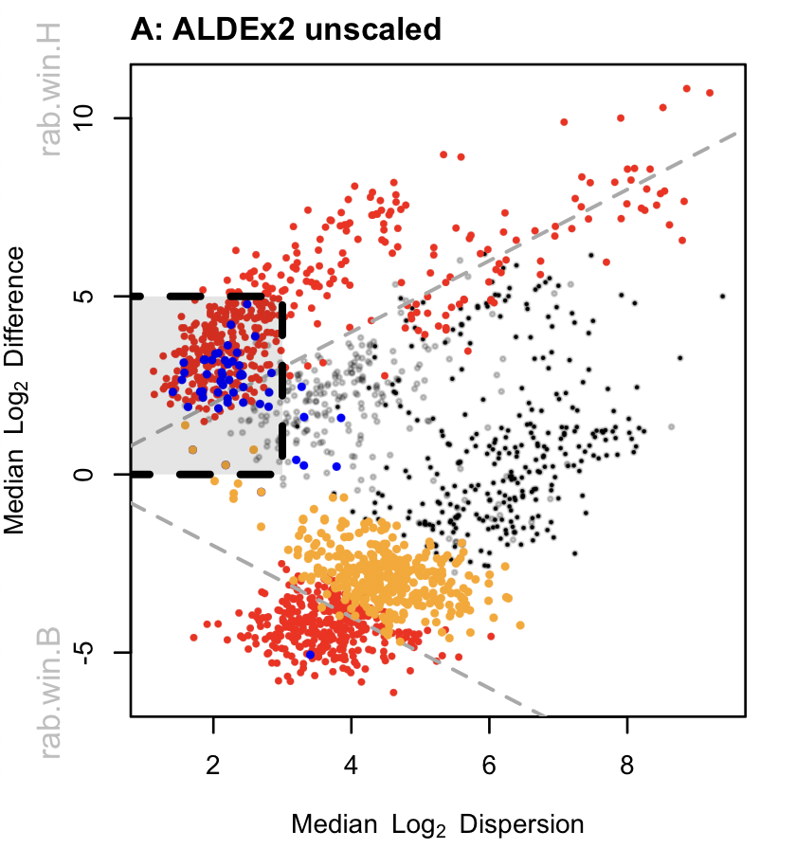
Meta-transcriptomes …
Effect plot
Bit of a mess
Housekeeping genes not centered
HK FP boxed (rRNA, Tsc’n, Gly …)
False negatives not significant
Gamma=NULL

Slide 35
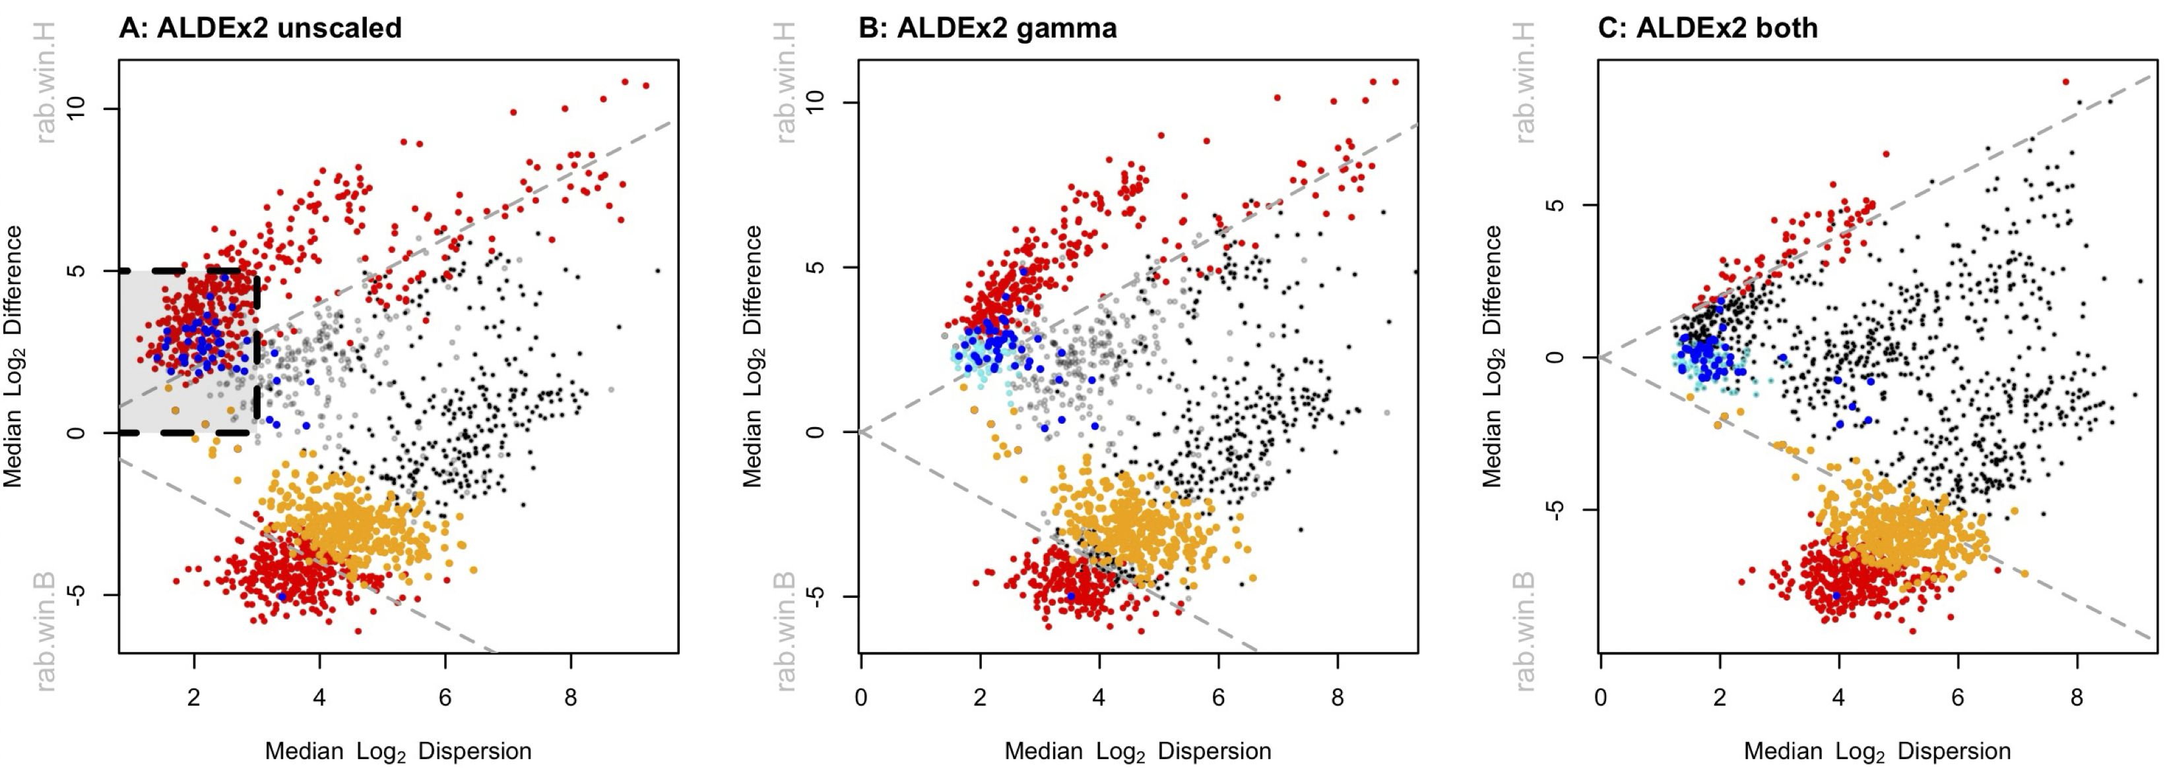
Meta-transcriptomes …
Gamma=NULL
Gamma=0.5
Ratio = 1 : 1
Gamma=0.5
Ratio = 1 : 1.15

Slide 36
Meta-transcriptomes …
CAMP resistance
Metabolism stuff
Nitrogen/Amine metabolism
Gamma=0.5
Ratio = 1 : 1.15

